Slide 1
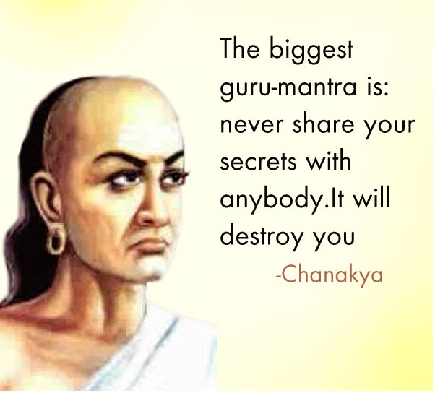
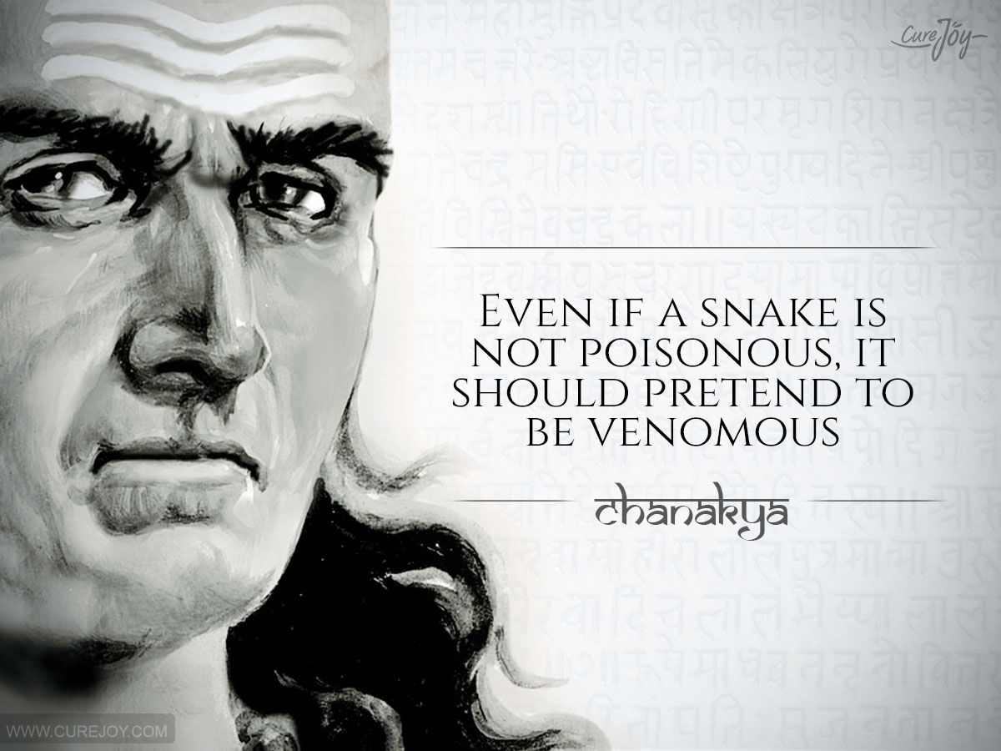
DO NOW
Consider your peers at Staten Island Tech: it could be who you
sit next to in class or someone you take the bus home with
after school. If you met another student who spoke like this
would you be friends with them?

Slide 2
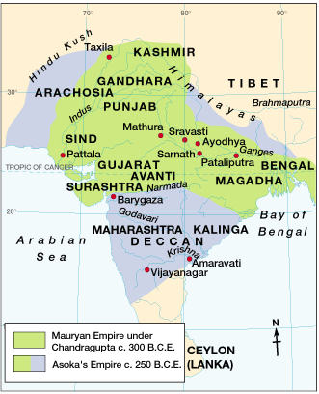
The Mauryan Empire
321 BCE – 185 BCE
Around 323 B.C.E, a great empire emerged in northern India. The rulers of this empire conquered most of northern and central India.

Slide 3
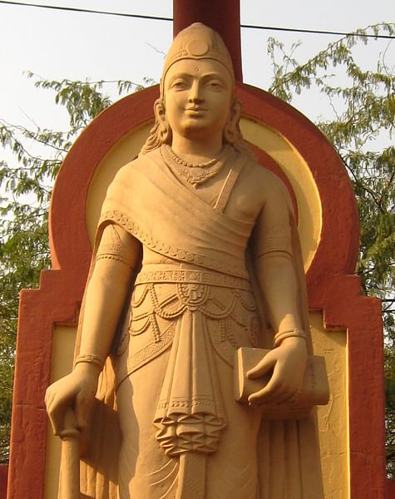
Chandragupta Maurya: 321 BCE BCE298 BCE
First emperor to unite a large region of India through military conquest.
Adopts a centralized bureaucracy where he divided his empire into provinces, then districts for tax assessments and law enforcement. His administration oversaw trade and agricultural production and this new system was enforced under a legal code with the authority of the army.
301 BCE → gave up his throne & became a Jain - Jainism prescribes a path of non-injury (ahimsa) towards all living beings. Practitioners believe non-violence and self-control are the means to liberation from samsara.

Slide 4
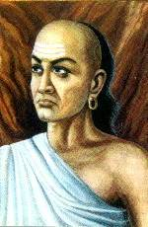
Focus: How did the Mauryan empire Manage to Unite the sub-continent?
Chanakya or Kautilya
Chandragupta’s advisor from the Brahmin caste.
Wrote the Arthashastra which is a Sanskrit term meaning “Statecraft.”
A guide for the king and his ministers:
Supports royal power.
The great evil in society is anarchy (a state of disorder due to absence or non-recognition of authority).
Therefore, a single authority is needed to employ force when necessary!

Slide 5
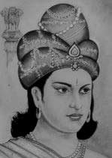
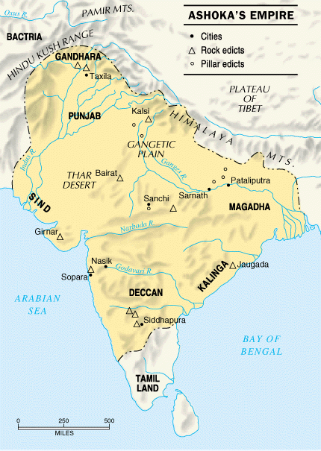
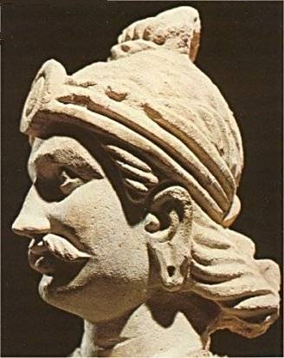
Ashoka (304 – 232 BCE)
Emperor Ashoka converted to Buddhism and dedicated his life to its practices after witnessing a gruesome battle.
Emperor Ashoka promoted religious tolerance.
He improved roads, built hospitals, and sent teachers throughout the empire to encourage education and the spread Buddhism.
Ashoka’s Empire

Slide 6
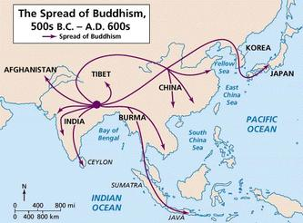
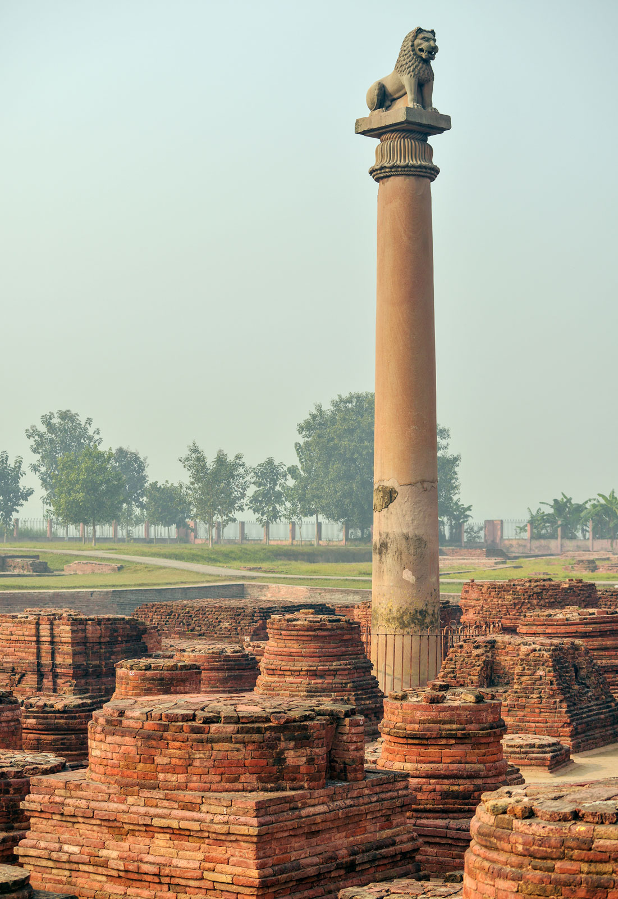
Ashoka’s Law Code
Stone edicts found in India, Nepal, Pakistan, & Afghanistan.
Buddhist laws and principles were written on the statutes.
Written mostly in Sanskrit, but one was in Greek and Aramaic.
Each pillar or stupa is 40’-50’ high.
Stone edicts found in India, Nepal, Pakistan, & Afghanistan.
Buddhist laws and principles were written on the statutes.
Written mostly in Sanskrit, but one was in Greek and Aramaic.
Each pillar or stupa is 40’-50’ high.

Slide 7
Quotes from the Arthashastra, a legal and political treatise produced for Emperor Chandragupta Maurya, circa 300 B.C.E.
“Without government, rises disorder as in the proverbs. In the absence of governance, the strong will swallow the weak.
In the presence of governance, the weak resists the strong.”
“It is power and power alone which, only when exercised by the king with impartiality and in proportion to guilt either over his son or
his enemy, maintains both this world and the next. The just and victorious king administers justice in accordance with Dharma
(established law).
“As one plucks one ripe fruit after another from a garden, so should the king from his kingdom. Out of fear for his own destruction,
he should avoid unripe ones, which give rise to revolts.”
“Marriage precedes all other duties of life. The different kinds of marriage are:
the giving in marriage of a bride well-adorned [with a dowry]…
the giving in marriage of a bride [in exchange] for a couple of cows
the giving in marriage of a bride to a priest
the voluntary union of a maiden and her lover
the giving in marriage of a bride after receiving plenty of wealth from the groom’s family
the abduction of a bride by a suitor
Of these, the first three are ancestral customs of old and are valid on their being approved of by the father [of the bride].
The rest are to be sanctioned by both the father and the mother…Sons begotten by men of higher caste and women of lower caste
are called anuloma and are considered to be of mixed caste.
Sons begotten by men of lower caste and women of higher caste are called pratiloma and originate on account of kings violating
all norms of proper behavior.”

Slide 8

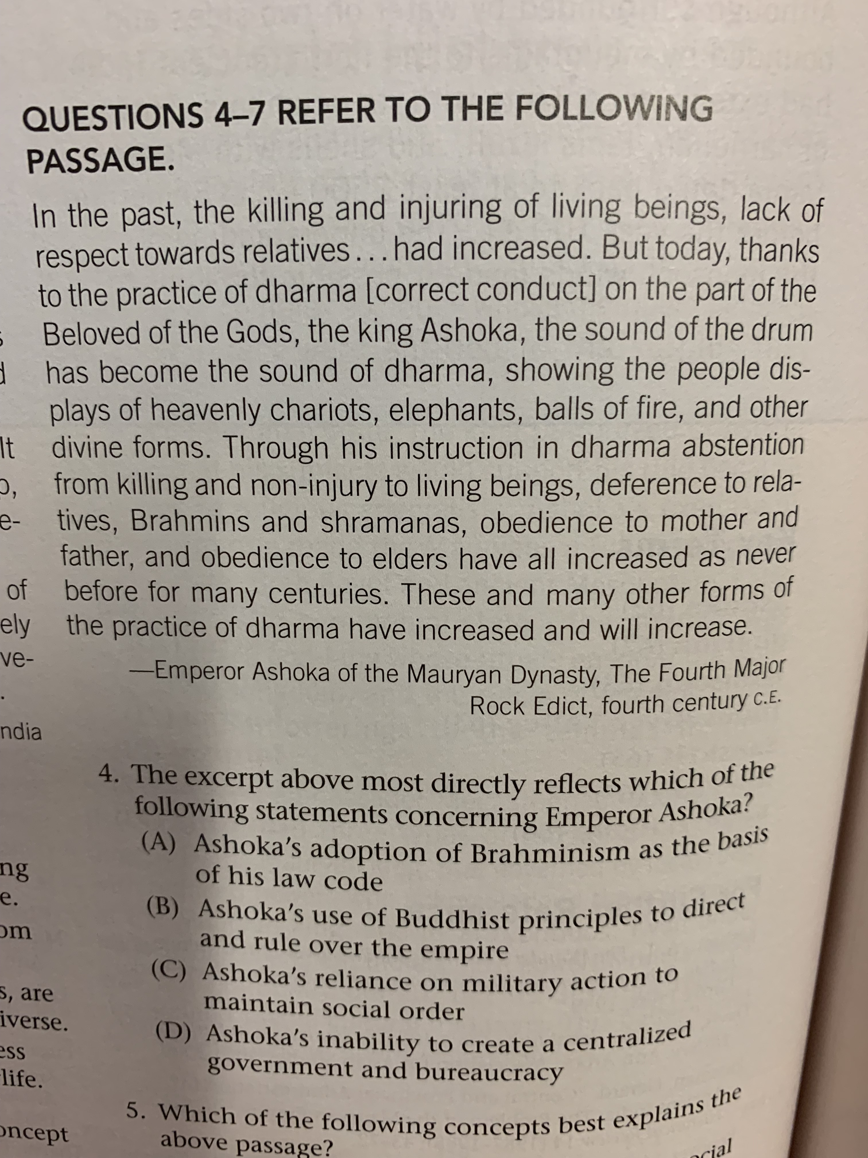
One of Emperor Ashoka’s many Rock Edicts
In the context of Buddhism, the Hindu concept of DHARMA transformed and now referred to the teachings of the Buddha.
Under Buddhism people’s new life path was to follow the teachings of the Buddha.

Slide 9
The Laws of Manu: Primary Source written from about 100-300 CE, five hundred years after the life of Emperor Ashoka. By this point Indian society had returned to Hinduism for its primary cultural framework.
•Justice, being violated, destroys; justice, being preserved, preserves: therefore, justice must not be violated, lest violated justice destroy us.'
• He only is a perfect man who consists (of three persons united), his wife, himself, and his offspring; thus says the Veda, and learned Brahmanas propound this teaching, 'The husband is declared to be one with the wife.’
• “A husband should be worshiped as a God.”
• “A wife, a son, and a slave, these three are declared to have no property. The wealth which they earn is acquired for him to whom they belong.”
“A king, desirous of investigating law cases, must enter his court of justice, preserving a dignified demeanor, together with Brahmanas and with experienced councilors.
When by the disposition of his heart he becomes indifferent to all objects, he obtains eternal happiness both in this world and after death.

Slide 10
Pair Share: According to the following quotes; What was the predominant view and Source of Social Division in Classical Indian society?
The Laws of Manu Continued
The Vedas, the sacred tradition, the customs of virtuous men, and one's own pleasure, they declare to be the fourfold means of defining the sacred law. - Manusmriti 2.12
87. But in order to protect this universe He, the most resplendent one, assigned separate (duties and) occupations to those who sprang from his mouth, arms, thighs, and feet.
88. To Brahmanas he assigned teaching and studying (the Veda), sacrificing for their own benefit and for others, giving and accepting (of alms).
89. The Kshatriya he commanded to protect the people, to bestow gifts, to offer sacrifices, to study (the Veda), and to abstain from attaching himself to sensual pleasures;
90. The Vaisya to tend cattle, to bestow gifts, to offer sacrifices, to study (the Veda), to trade, to lend money, and to cultivate land.
91. One occupation only the lord prescribed to the Sudra, to serve meekly even these (other) three castes.
93. As the Brahmana sprang from (Brahman's) mouth, as he was the first-born, and as he possesses the Veda, he is by right the lord of this whole creation.
-Manusmriti 1.87-93

